Slide 1
Lane Detection in Adverse Visibility Conditions
CS 766 – Computer Vision
Spring 2019
Rohit Sharma, Varun Batra, Vibhor Goel
Under the supervision of Prof. Mohit Gupta

Slide 2
Agenda

Slide 3
Introduction
Lane Detection

Slide 4
What are we doing?
Lane Detection: Task of tracking lanes for autonomous driving
Why is it important?
Better automation and enhanced driving experience
Avoid accidents
Robust Lane Detection in adverse visibility conditions is still a challenge.
Adverse visibility conditions: bad light, glaze, rain, crowd, …
In a nutshell, we are making Lane Detection better!

Slide 5
How are we doing?
Spatial As Deep: Spatial CNN for Traffic Scene Understanding – AAAI-18
Explained in detail ahead

Slide 6
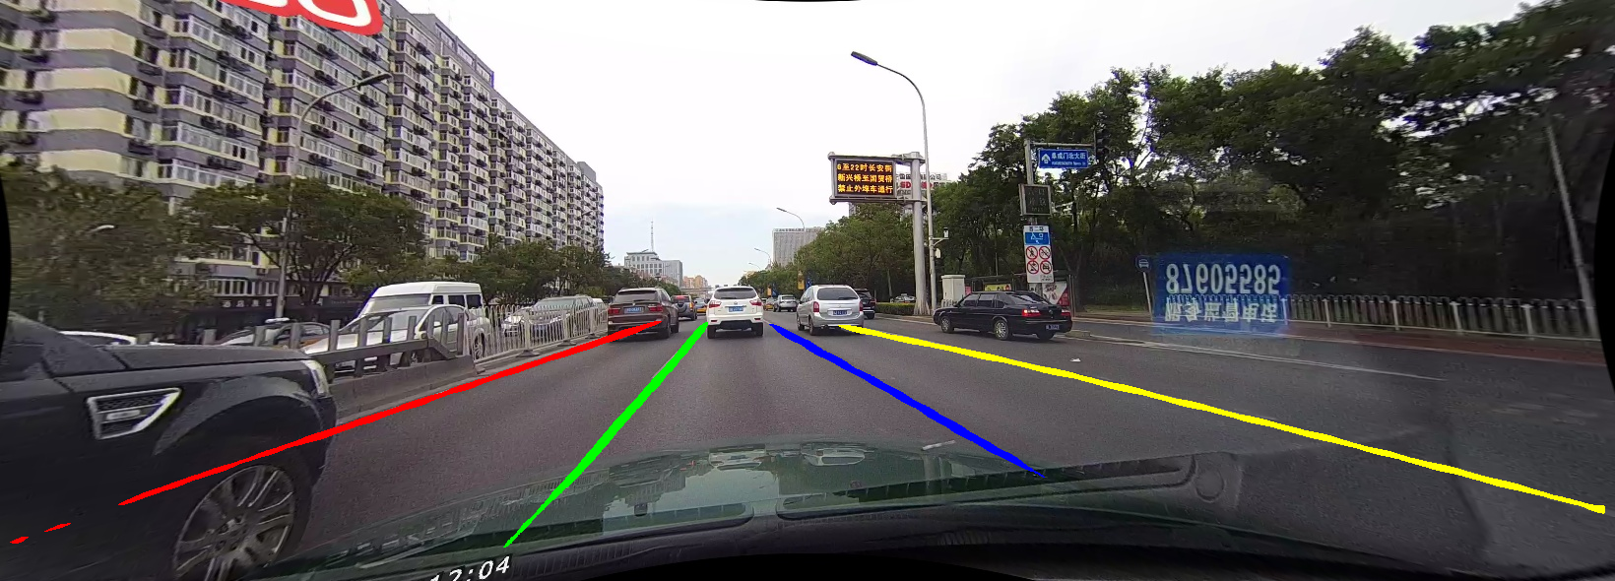
Why we are doing this
Current Lane Detection techniques are good in well lit scenarios with visible lane markings…

Slide 7
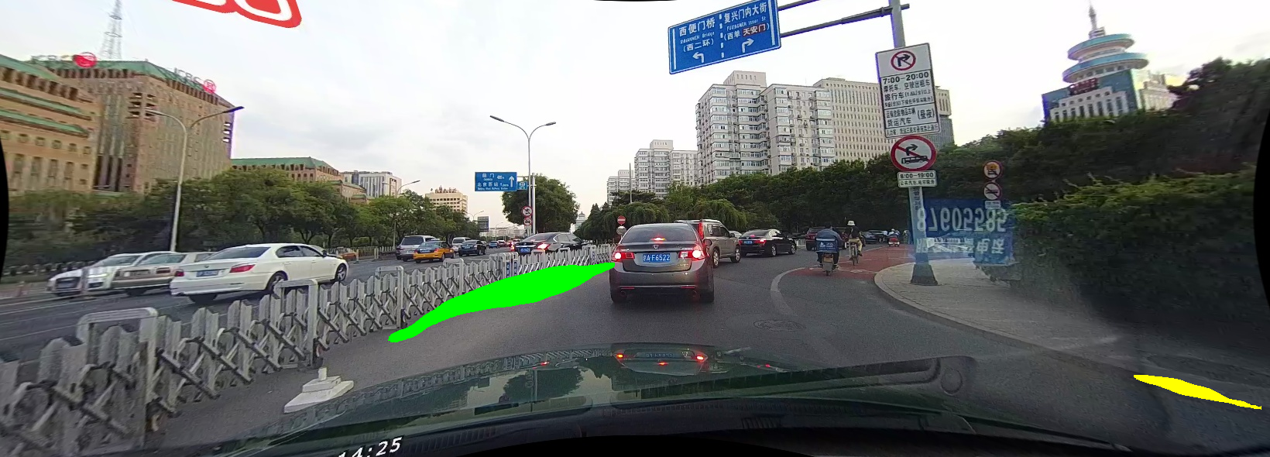
But.. Also…
But not so good in adverse conditions such as curved lanes or bad visibility conditions…

Slide 8
As we can see from these results:
Add the table of % accuracies
We see that for adverse conditions there is a sharp decrease in model accuracy

Slide 9
Dataset
CULane
Large scale lane detection dataset from the Chinese University of Hong Kong
First dataset with labels for multiple challenging scenarios
Some properties of CULane
55 hours of videos with 133,235 frames.
88880 for training set
9675 for validation set
34680 for test set

Slide 10
CULane Details

Slide 11
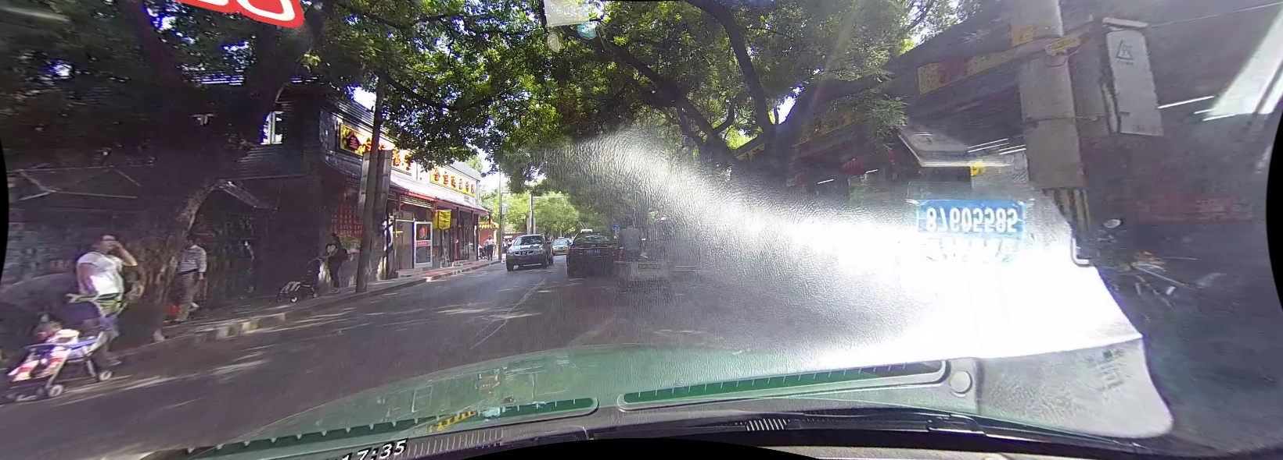
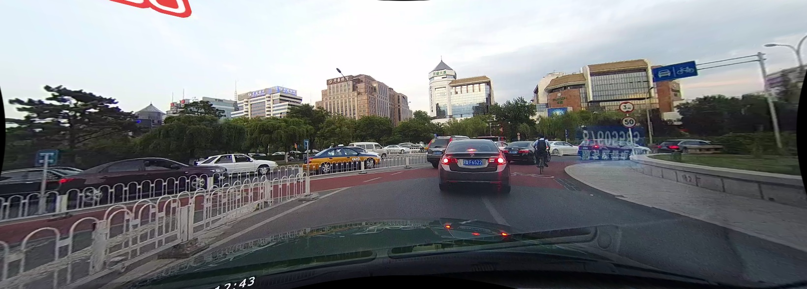
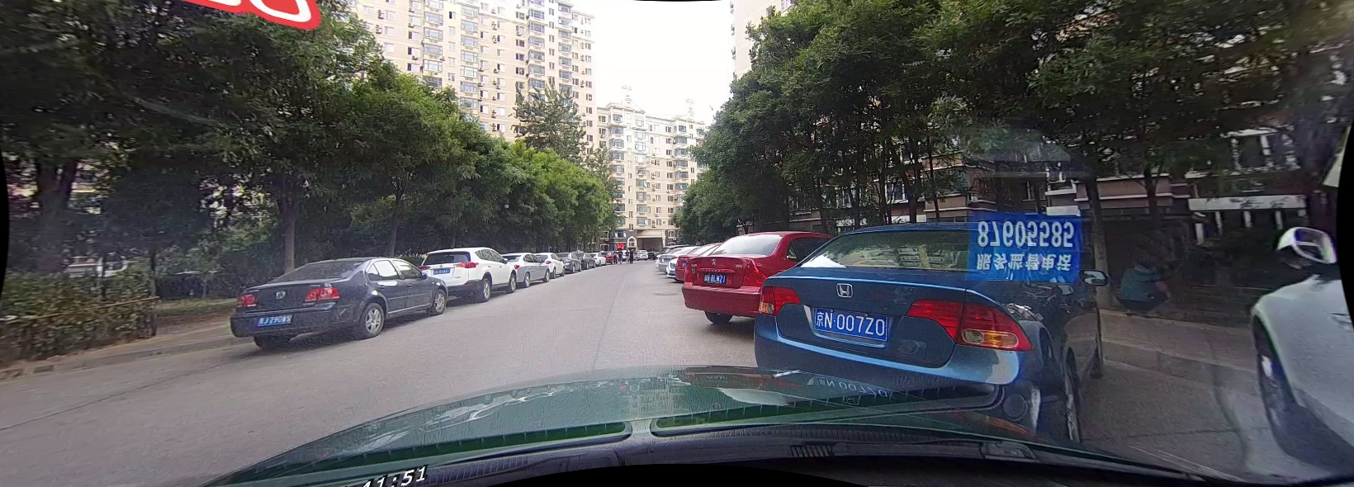
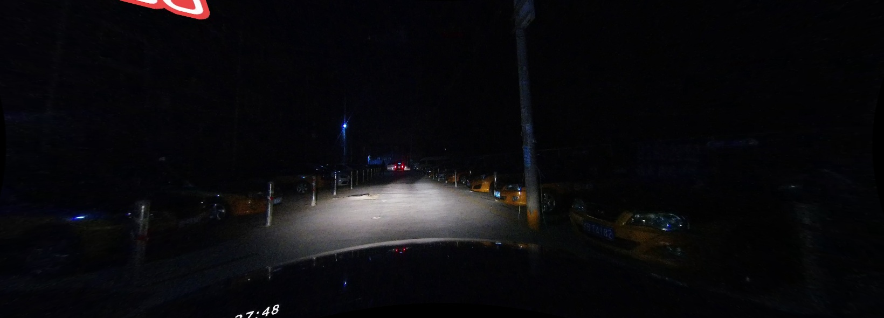
Adverse Conditions
Glaze
Curved lanes
Rain
No lanes
Night

Slide 12
Current State of the Art - Spatial CNN
Why CNNs can’t solve lane detection?
CNN extract semantics from raw pixels
Problem: Capacity to capture spatial relationships of pixels
How SCNN tackles lane detection?
SCNN can learn spatial relationships like strong shape priors of lane markings
SCNN generalizes deep layer-by-layer convolutions to slice-by-slice convolutions
Result: Enables message passing between pixels across rows and columns in a layer

Slide 13
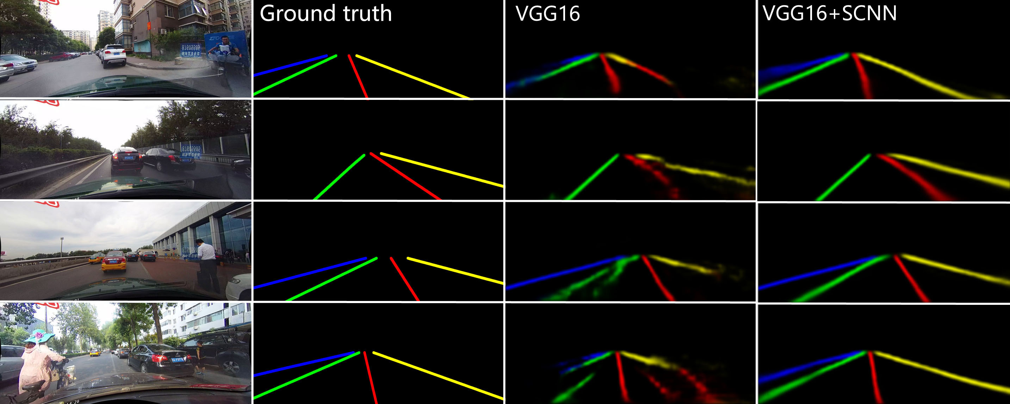
Spatial CNN
Spatial CNN
Comparison of SCNN with VGG16:

Slide 14
Spatial CNN Results
Current State of the art:
We see that for adverse conditions there is a sharp decrease in model performance
Category | SCNN (F1-measure)
Normal | 90.2
Crowded | 71.9
Night | 64.6
No line | 45.8
Shadow | 73.8
Arrow | 83.8
Dazzle Light | 59.5
Curve | 63.4
Overall | 71.3

Slide 15
Methodology
SCNN + De-Glaze

Slide 16
De-Glazing
We aim to make an image de-glazer to tackle the dazzle light
Add Dazzle Examples

Slide 17
De-Glazing
Approach:
Localize Glaze Region
Assumption:
Glaze pixels are saturated – use a threshold
Clean the pixels with glaze
Heuristics:
Bottom three regions
Interpolate pixels with neighboring images
Gaussian smooth the region

Slide 18
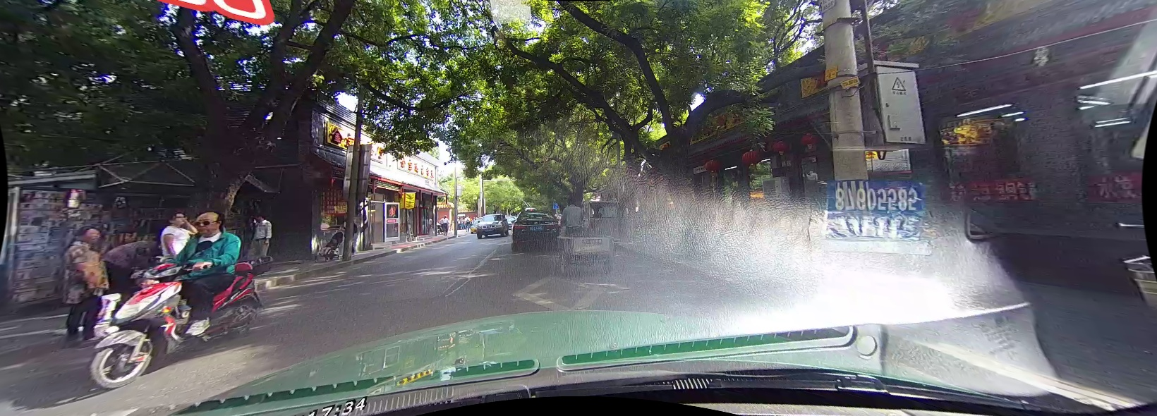
De-Glazing
Example 1

Slide 19
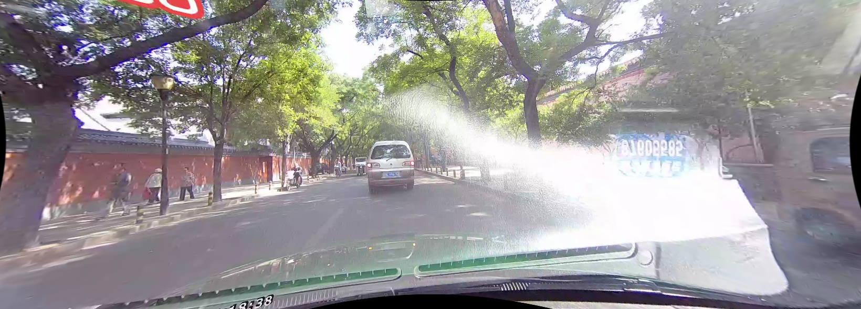
De-Glazing
Example 2

Slide 20
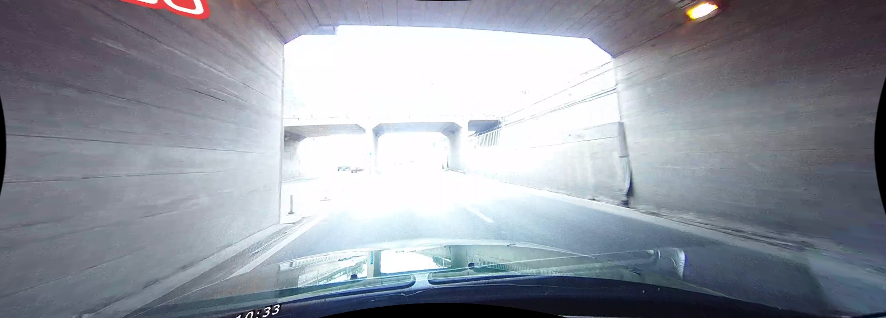
De-glazing
Example 3

Slide 21
Results
Evaluation on Glaze Subset

Slide 22
Results on Glaze Subset
SCNN
SCNN + De-Glaze
Measure | Value
Precision | 0.5762
Recall | 0.5519
F1-Measure | 0.5638
Measure | Value
Precision | 0.5717
Recall | 0.5651
F1-Measure | 0.5684
Improvement of 0.82% in F1-measure over the state of the art.
The Recall of the model improved at the cost of Precision.
The recall improved (by 0.0132) because deglaze makes more lanes visible.
The precision decreased (by 0.0045) indicating that deglaze introduced more noise.
Notes:
Improve heuristics or come up with better techniques to tackle glaze to improve the performance of the model

Slide 23
Conclusion
Discussion
Future Work

Slide 24
Discussion
Challenges and Learnings:
Finding a lane detection dataset with diverse conditions
Naïve deep learning technique called “Spatial CNN”
Setting up GPU and OpenCV
Understanding the existing SCNN flow from label generation to lane prediction to evaluation
Techniques for de-glazing: coming up with heuristics, …
Improve heuristics or come up with better techniques to tackle glaze to improve the performance of the model

Slide 25
Discussion
Future Work:
Building on the de-glazer
Incorporate optical flow from neighboring images to extrapolate new lane position
Models to handle other adverse conditions like rain, crowd, …
Checkout “Project Website” for more information

Slide 26
Thank You

